Slide 1
Displaying Data from Multiple Tables and Sub query
Md. Ariful Islam Khandaker
Assistant Professor, IICT
Khulna University of Engineering & Technology

Slide 2
SQL JOIN
The JOIN keyword is used in an SQL statement to query data from two or more tables, based on a relationship between certain columns in these tables.
Tables in a database are often related to each other with keys.
Look at the "Persons" table:
P_Id | LastName | FirstName | Address | City
1 | Hansen | Ola | Timoteivn 10 | Sandnes
2 | Svendson | Tove | Borgvn 23 | Sandnes
3 | Pettersen | Kari | Storgt 20 | Stavanger
Next, we have the "Orders" table:
O_Id | OrderNo | P_Id
1 | 77895 | 3
2 | 44678 | 3
3 | 22456 | 1
4 | 24562 | 1
5 | 34764 | 15

Slide 3
Types of Joins
Joins that are compliant with the SQL:1999 standard include the following:
  Join (Natural Join)
  Self Join
  Left Join.
  Right Join
  Cross joins
Notes:
Oracle Database 11g: SQL Fundamentals I 6 - <number>
Types of Joins
To join tables, you can use a join syntax that is compliant with the SQL:1999 standard.
Note: Before the Oracle9i release, the join syntax was different from the American National Standards Institute (ANSI) standards. The SQL:1999–compliant join syntax does not offer any performance benefits over the Oracle-proprietary join syntax that existed in the prior releases. For detailed information about the proprietary join syntax, see Appendix C: Oracle Join Syntax.
Note: The following slide discusses the SQL:1999 join syntax.

Slide 4
SQL INNER JOIN Keyword
The INNER JOIN keyword returns rows when there is at least one match in both tables.
SQL INNER JOIN Syntax
    SELECT column_name(s)
    FROM table_name1
    INNER JOIN table_name2
    ON table_name1.column_name=table_name2.column_name
We use the following SELECT statement:
    SELECT Persons.LastName, Persons.FirstName, Orders.OrderNo
    FROM Persons
    INNER JOIN Orders
    ON Persons.P_Id=Orders.P_Id
    ORDER BY Persons.LastName
The result-set will look like this:
LastName | FirstName | OrderNo
Hansen | Ola | 22456
Hansen | Ola | 24562
Pettersen | Kari | 77895
Pettersen | Kari | 44678
Notes:
Oracle Database 11g: SQL Fundamentals I 6 - <number>
Retrieving Records with Natural Joins
In the example in the slide, the LOCATIONS table is joined to the DEPARTMENT table by the LOCATION_ID column, which is the only column of the same name in both tables. If other common columns were present, the join would have used them all.
Natural Joins with a WHERE Clause
Additional restrictions on a natural join are implemented by using a WHERE clause. The following example limits the rows of output to those with a department ID equal to 20 or 50:
SELECT department_id, department_name,
location_id, city
FROM departments
NATURAL JOIN locations
WHERE department_id IN (20, 50);

Slide 5
Applying Additional Conditions to a Join
Use the AND clause or the WHERE clause to apply additional conditions:
SELECT e.employee_id, e.last_name, e.department_id,
d.department_id, d.location_id
FROM employees e,departments d
where e.department_id = d.department_id
AND e.manager_id = 149 ;
Or
SELECT e.employee_id, e.last_name, e.department_id,
d.department_id, d.location_id
FROM employees e JOIN departments d
ON (e.department_id = d.department_id)
WHERE e.manager_id = 149 ;
Notes:
Oracle Database 11g: SQL Fundamentals I 6 - <number>
Applying Additional Conditions to a Join
You can apply additional conditions to the join.
The example shown performs a join on the EMPLOYEES and DEPARTMENTS tables and, in addition, displays only employees who have a manager ID of 149. To add additional conditions to the ON clause, you can add AND clauses. Alternatively, you can use a WHERE clause to apply additional conditions.

Slide 6
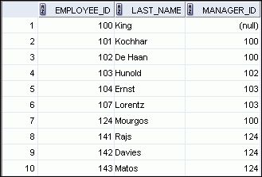
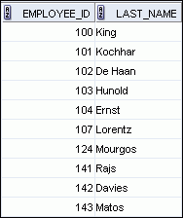
Joining a Table to Itself
EMPLOYEES (WORKER)
EMPLOYEES (MANAGER)
…
…
MANAGER_ID in the WORKER table is equal to EMPLOYEE_ID in the MANAGER table.
Notes:
Oracle Database 11g: SQL Fundamentals I 6 - <number>
Joining a Table to Itself
Sometimes you need to join a table to itself. To find the name of each employee’s manager, you need to join the EMPLOYEES table to itself, or perform a self-join. For example, to find the name of Lorentz’s manager, you need to:
Find Lorentz in the EMPLOYEES table by looking at the LAST_NAME column
Find the manager number for Lorentz by looking at the MANAGER_ID column. Lorentz’s manager number is 103.
Find the name of the manager with EMPLOYEE_ID 103 by looking at the LAST_NAME column. Hunold’s employee number is 103, so Hunold is Lorentz’s manager.
In this process, you look in the table twice. The first time you look in the table to find Lorentz in the LAST_NAME column and the MANAGER_ID value of 103. The second time you look in the EMPLOYEE_ID column to find 103 and the LAST_NAME column to find Hunold.

Slide 7
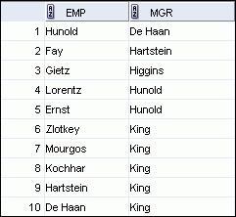
Self-Joins Using the ON Clause
SELECT worker.last_name emp, manager.last_name mgr
FROM employees worker JOIN employees manager
ON (worker.manager_id = manager.employee_id);
…
Notes:
Oracle Database 11g: SQL Fundamentals I 6 - <number>
Self-Joins Using the ON Clause
The ON clause can also be used to join columns that have different names, within the same table or in a different table.
The example shown is a self-join of the EMPLOYEES table, based on the EMPLOYEE_ID and MANAGER_ID columns.
Note: The parenthesis around the joined columns as in the slide example, (e.manager_id = m.employee_id) is optional. So, even ON e.manager_id = m.employee_id will work.

Slide 8
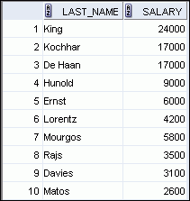
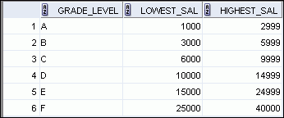

Nonequijoins
EMPLOYEES
JOB_GRADES
JOB_GRADES table defines the LOWEST_SAL and HIGHEST_SAL range of values for each GRADE_LEVEL. Hence, the GRADE_LEVEL column can be used to assign grades to each employee.
…
Notes:
Oracle Database 11g: SQL Fundamentals I 6 - <number>
Nonequijoins
A nonequijoin is a join condition containing something other than an equality operator.
The relationship between the EMPLOYEES table and the JOB_GRADES table is an example of a nonequijoin. The SALARY column in the EMPLOYEES table ranges between the values in the LOWEST_SAL and HIGHEST_SAL columns of the JOB_GRADES table. Hence, each employee can be graded based on their salary. The relationship is obtained using an operator other than the equality (=) operator.

Slide 9
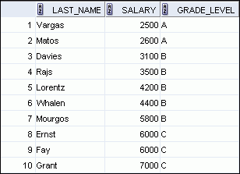
Retrieving Records with Nonequijoins
SELECT e.last_name, e.salary, j.grade
FROM employees e JOIN salgrade j
ON e.salary
BETWEEN j.losal AND j.hisal;
…
Notes:
Oracle Database 11g: SQL Fundamentals I 6 - <number>
Retrieving Records with Nonequijoins
The slide example creates a nonequijoin to evaluate an employee’s salary grade. The salary must be between any pair of the low and high salary ranges.
It is important to note that all employees appear exactly once when this query is executed. No employee is repeated in the list. There are two reasons for this:
None of the rows in the JOB_GRADES table contain grades that overlap. That is, the salary value for an employee can lie only between the low salary and high salary values of one of the rows in the salary grade table.
All of the employees’ salaries lie within the limits provided by the job grade table. That is, no employee earns less than the lowest value contained in the LOWEST_SAL column or more than the highest value contained in the HIGHEST_SAL column.
Note: Other conditions (such as <= and >=) can be used, but BETWEEN is the simplest. Remember to specify the low value first and the high value last when using the BETWEEN condition. The Oracle server translates the BETWEEN condition to a pair of AND conditions. Therefore, using BETWEEN has no performance benefits, but should be used only for logical simplicity.
Table aliases have been specified in the slide example for performance reasons, not because of possible ambiguity.

Slide 10
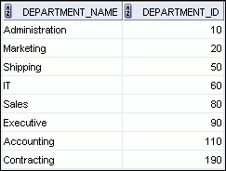
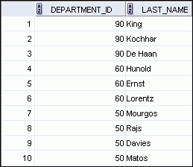

Returning Records with No Direct Match with Outer Joins
DEPARTMENTS
EMPLOYEES
…
There are no employees in department 190.
Notes:
Oracle Database 11g: SQL Fundamentals I 6 - <number>
Returning Records with No Direct Match with Outer Joins
If a row does not satisfy a join condition, the row does not appear in the query result. For example, in the equijoin condition of EMPLOYEES and DEPARTMENTS tables, department ID 190 does not appear because there are no employees with that department ID recorded in the EMPLOYEES table. Therefore, instead of seeing 20 employees in the result set, you see 19 records.
To return the department record that does not have any employees, you can use an outer join.

Slide 11
INNER Versus OUTER Joins
  In SQL:1999, the join of two tables returning only matched rows is called an inner join.
  A join between two tables that returns the results of the inner join as well as the unmatched rows from the left (or right) table is called a left (or right) outer join.
  A join between two tables that returns the results of an inner join as well as the results of a left and right join is a full outer join.
Notes:
Oracle Database 11g: SQL Fundamentals I 6 - <number>
INNER Versus OUTER Joins
Joining tables with the NATURAL JOIN, USING, or ON clauses results in an inner join. Any unmatched rows are not displayed in the output. To return the unmatched rows, you can use an outer join. An outer join returns all rows that satisfy the join condition and also returns some or all of those rows from one table for which no rows from the other table satisfy the join condition.
There are three types of outer joins:
LEFT OUTER
RIGHT OUTER
FULL OUTER

Slide 12
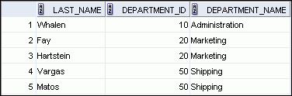

LEFT OUTER JOIN
SELECT e.last_name, e.department_id, d.department_name
FROM employees e LEFT OUTER JOIN departments d
ON (e.department_id = d.department_id) ;
…
Notes:
Oracle Database 11g: SQL Fundamentals I 6 - <number>
LEFT OUTER JOIN
This query retrieves all rows in the EMPLOYEES table, which is the left table, even if there is no match in the DEPARTMENTS table.

Slide 13
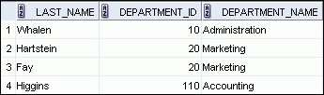

RIGHT OUTER JOIN
SELECT e.last_name, e.department_id, d.department_name
FROM employees e RIGHT OUTER JOIN departments d
ON (e.department_id = d.department_id) ;
…
Notes:
Oracle Database 11g: SQL Fundamentals I 6 - <number>
RIGHT OUTER JOIN
This query retrieves all rows in the DEPARTMENTS table, which is the right table, even if there is no match in the EMPLOYEES table.

Slide 14
Cartesian Products
  A Cartesian product is formed when:
    A join condition is omitted
    A join condition is invalid
    All rows in the first table are joined to all rows in the second table
  To avoid a Cartesian product, always include a valid join condition.
Notes:
Oracle Database 11g: SQL Fundamentals I 6 - <number>
Cartesian Products
When a join condition is invalid or omitted completely, the result is a Cartesian product, in which all combinations of rows are displayed. All rows in the first table are joined to all rows in the second table.
A Cartesian product tends to generate a large number of rows and the result is rarely useful. You should, therefore, always include a valid join condition unless you have a specific need to combine all rows from all tables.
However, Cartesian products are useful for some tests when you need to generate a large number of rows to simulate a reasonable amount of data.

Slide 15
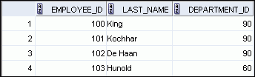
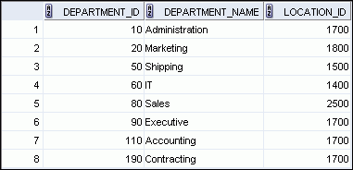

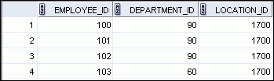

Generating a Cartesian Product
EMPLOYEES (20 rows)
DEPARTMENTS (8 rows)
…
Cartesian product:
20 x 8 = 160 rows
…
Notes:
Oracle Database 11g: SQL Fundamentals I 6 - <number>
Generating a Cartesian Product
A Cartesian product is generated if a join condition is omitted. The example in the slide displays the employee last name and the department name from the EMPLOYEES and DEPARTMENTS tables. Because no join condition was specified, all rows (20 rows) from the EMPLOYEES table are joined with all rows (8 rows) in the DEPARTMENTS table, thereby generating 160 rows in the output.

Slide 16
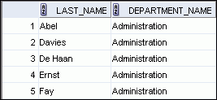

Creating Cross Joins
  The CROSS JOIN clause produces the cross-product of two tables.
  This is also called a Cartesian product between the two tables.
SELECT last_name, department_name
FROM employees
CROSS JOIN departments ;
…
Notes:
Oracle Database 11g: SQL Fundamentals I 6 - <number>
Creating Cross Joins
The example in the slide produces a Cartesian product of the EMPLOYEES and DEPARTMENTS tables.

Slide 17
The SQL UNION Operator
The UNION operator is used to combine the result-set of two or more SELECT statements.
Notice that each SELECT statement within the UNION must have the same number of columns. The columns must also have similar data types. Also, the columns in each SELECT statement must be in the same order.
SQL UNION Syntax
    SELECT column_name(s) FROM table_name1
    UNION
    SELECT column_name(s) FROM table_name2

Slide 18
SQL UNION Example
"Employees_Norway":
E_ID | E_Name
01 | Hansen, Ola
02 | Svendson, Tove
03 | Svendson, Stephen
04 | Pettersen, Kari
"Employees_USA":
E_ID | E_Name
01 | Turner, Sally
02 | Kent, Clark
03 | Svendson, Stephen
04 | Scott, Stephen
Now we want to list all the different employees in Norway and USA. We use the following SELECT statement:
SELECT E_Name FROM Employees_Norway
UNION
SELECT E_Name FROM Employees_USA

Slide 19



Using a Subquery to Solve a Problem
Who has a salary greater than Abel’s?
Main query:
Which employees have salaries greater than Abel’s salary?
Subquery:
What is Abel’s salary?
Notes:
Oracle Database 11g: SQL Fundamentals I 7 - <number>
Using a Subquery to Solve a Problem
Suppose you want to write a query to find out who earns a salary greater than Abel’s salary.
To solve this problem, you need two queries: one to find how much Abel earns, and a second query to find who earns more than that amount.
You can solve this problem by combining the two queries, placing one query inside the other query.
The inner query (or subquery) returns a value that is used by the outer query (or main query). Using a subquery is equivalent to performing two sequential queries and using the result of the first query as the search value in the second query.

Slide 20
Subquery Syntax
SELECT select_list
FROM table
WHERE expr operator
(SELECT select_list
FROM table);
  The subquery (inner query) executes before the main query (outer query).
  The result of the subquery is used by the main query.
Notes:
Oracle Database 11g: SQL Fundamentals I 7 - <number>
Subquery Syntax
A subquery is a SELECT statement that is embedded in the clause of another SELECT statement. You can build powerful statements out of simple ones by using subqueries. They can be very useful when you need to select rows from a table with a condition that depends on the data in the table itself.
You can place the subquery in a number of SQL clauses, including the following:
WHERE clause
HAVING clause
FROM clause
In the syntax:
operator includes a comparison condition such as >, =, or IN
Note: Comparison conditions fall into two classes: single-row operators (>, =, >=, <, <>, <=) and multiple-row operators (IN, ANY, ALL).
The subquery is often referred to as a nested SELECT, sub-SELECT, or inner SELECT statement. The subquery generally executes first, and its output is used to complete the query condition for the main (or outer) query.

Slide 21
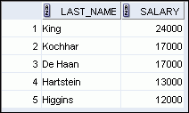
Using a Subquery
SELECT last_name, salary
FROM employees
WHERE salary >
(SELECT salary
FROM employees
WHERE last_name = 'Abel');
11000
Notes:
Oracle Database 11g: SQL Fundamentals I 7 - <number>
Using a Subquery
In the slide, the inner query determines the salary of employee Abel. The outer query takes the result of the inner query and uses this result to display all the employees who earn more than employee Abel.

Slide 22
Guidelines for Using Sub queries
  Enclose subqueries in parentheses.
  Place subqueries on the right side of the comparison condition for readability (However, the subquery can appear on either side of the comparison operator.).
  Use single-row operators with single-row subqueries and multiple-row operators with multiple-row subqueries.
Notes:
Oracle Database 11g: SQL Fundamentals I 7 - <number>
Guidelines for Using Subqueries
A subquery must be enclosed in parentheses.
Place the subquery on the right side of the comparison condition for readability. However, the subquery can appear on either side of the comparison operator.
Two classes of comparison conditions are used in subqueries: single-row operators and
multiple-row operators.

Slide 23
Types of Subqueries
  Single-row subquery
  Multiple-row subquery
Main query
Subquery
returns
ST_CLERK
Main query
Subquery
returns
ST_CLERK
SA_MAN
Notes:
Oracle Database 11g: SQL Fundamentals I 7 - <number>
Types of Subqueries
Single-row subqueries: Queries that return only one row from the inner SELECT statement
Multiple-row subqueries: Queries that return more than one row from the inner SELECT statement
Note: There are also multiple-column subqueries, which are queries that return more than one column from the inner SELECT statement. These are covered in the Oracle Database 11g: SQL Fundamentals II course.

Slide 24
Single-Row Subqueries
  Return only one row
  Use single-row comparison operators
Operator
Meaning
=
Equal to
>
Greater than
>=
Greater than or equal to
<
Less than
<=
Less than or equal to
<>
Not equal to
Notes:
Oracle Database 11g: SQL Fundamentals I 7 - <number>
Single-Row Subqueries
A single-row subquery is one that returns one row from the inner SELECT statement. This type of subquery uses a single-row operator. The slide gives a list of single-row operators.
Example:
Display the employees whose job ID is the same as that of employee 141:
SELECT last_name, job_id
FROM employees
WHERE job_id =
(SELECT job_id
FROM employees
WHERE employee_id = 141);

Slide 25

Executing Single-Row Subqueries
SELECT last_name, job_id, salary
FROM employees
WHERE job_id =
(SELECT job_id
FROM employees
WHERE last_name = ‘Taylor’)
AND salary >
(SELECT salary
FROM employees
WHERE last_name = ‘Taylor’);
SA_REP
8600
Notes:
Oracle Database 11g: SQL Fundamentals I 7 - <number>
Executing Single-Row Subqueries
A SELECT statement can be considered as a query block. The example in the slide displays employees who do the same job as “Taylor,” but earn more salary than him.
The example consists of three query blocks: the outer query and two inner queries. The inner query blocks are executed first, producing the query results SA_REP and 8600, respectively. The outer query block is then processed and uses the values that were returned by the inner queries to complete its search conditions.
Both inner queries return single values (SA_REP and 8600, respectively), so this SQL statement is called a single-row subquery.
Note: The outer and inner queries can get data from different tables.

Slide 26

Using Group Functions in a Subquery
SELECT last_name, job_id, salary
FROM employees
WHERE salary =
(SELECT MIN(salary)
FROM employees);
2500
Notes:
Oracle Database 11g: SQL Fundamentals I 7 - <number>
Using Group Functions in a Subquery
You can display data from a main query by using a group function in a subquery to return a single row. The subquery is in parentheses and is placed after the comparison condition.
The example in the slide displays the employee last name, job ID, and salary of all employees whose salary is equal to the minimum salary. The MIN group function returns a single value (2500) to the outer query.

Slide 27

The HAVING Clause with Subqueries
  The Oracle server executes the subqueries first.
  The Oracle server returns results into the HAVING clause of the main query.
SELECT department_id, MIN(salary)
FROM employees
GROUP BY department_id
HAVING MIN(salary) >
(SELECT MIN(salary)
FROM employees
WHERE department_id = 50);
2500
…
Notes:
Oracle Database 11g: SQL Fundamentals I 7 - <number>
The HAVING Clause with Subqueries
You can use subqueries not only in the WHERE clause, but also in the HAVING clause. The Oracle server executes the subquery and the results are returned into the HAVING clause of the main query.
The SQL statement in the slide displays all the departments that have a minimum salary greater than that of department 50.
Example:
Find the job with the lowest average salary.
SELECT job_id, AVG(salary)
FROM employees
GROUP BY job_id
HAVING AVG(salary) = (SELECT MIN(AVG(salary))
FROM employees
GROUP BY job_id);

Slide 28
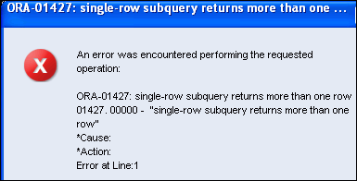
What Is Wrong with This Statement?
SELECT employee_id, last_name
FROM employees
WHERE salary =
(SELECT MIN(salary)
FROM employees
GROUP BY department_id);
Single-row operator with multiple-row subquery
Notes:
Oracle Database 11g: SQL Fundamentals I 7 - <number>
What Is Wrong with This Statement?
A common error with subqueries occurs when more than one row is returned for a single-row subquery.
In the SQL statement in the slide, the subquery contains a GROUP BY clause, which implies that the subquery will return multiple rows, one for each group that it finds. In this case, the results of the subquery are 4400, 6000, 2500, 4200, 7000, 17000, and 8300.
The outer query takes those results and uses them in its WHERE clause. The WHERE clause contains an equal (=) operator, a single-row comparison operator that expects only one value. The = operator cannot accept more than one value from the subquery and, therefore, generates the error.
To correct this error, change the = operator to IN.

Slide 29
No Rows Returned by the Inner Query
SELECT last_name, job_id
FROM employees
WHERE job_id =
(SELECT job_id
FROM employees
WHERE last_name = 'Haas');
Subquery returns no rows because there is no employee named “Haas.”
Notes:
Oracle Database 11g: SQL Fundamentals I 7 - <number>
No Rows Returned by the Inner Query
A common problem with subqueries occurs when no rows are returned by the inner query.
In the SQL statement in the slide, the subquery contains a WHERE clause. Presumably, the intention is to find the employee whose name is Haas. The statement is correct, but selects no rows when executed.
Because, there is no employee named Haas. So the subquery returns no rows. The outer query takes the results of the subquery (null) and uses these results in its WHERE clause. The outer query finds no employee with a job ID equal to null, and so returns no rows. If a job existed with a value of null, the row is not returned because comparison of two null values yields a null; therefore, the WHERE condition is not true.

Slide 30
Multiple-Row Subqueries
  Return more than one row
  Use multiple-row comparison operators
Operator
Meaning
IN
Equal to any member in the list
ANY
Must be preceded by =, !=, >, <, <=, >=. Compares a value to each value in a list or returned by a query. Evaluates to FALSE if the query returns no rows.
ALL
Must be preceded by =, !=, >, <, <=, >=. Compares a value to every value in a list or returned by a query. Evaluates to TRUE if the query returns no rows.
Notes:
Oracle Database 11g: SQL Fundamentals I 7 - <number>
Multiple-Row Subqueries
Subqueries that return more than one row are called multiple-row subqueries. You use a multiple-row operator, instead of a single-row operator, with a multiple-row subquery. The multiple-row operator expects one or more values:
SELECT last_name, salary, department_id
FROM employees
WHERE salary IN (SELECT MIN(salary)
FROM employees
GROUP BY department_id);
Example:
Find the employees who earn the same salary as the minimum salary for each department.
The inner query is executed first, producing a query result. The main query block is then processed and uses the values that were returned by the inner query to complete its search condition. In fact, the main query appears to the Oracle server as follows:
SELECT last_name, salary, department_id
FROM employees
WHERE salary IN (2500, 4200, 4400, 6000, 7000, 8300, 8600, 17000);

Slide 31
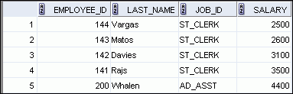

Using the ANY Operator in Multiple-Row Subqueries
SELECT employee_id, last_name, job_id, salary
FROM employees
WHERE salary < ANY
(SELECT salary
FROM employees
WHERE job_id = 'IT_PROG')
AND job_id <> 'IT_PROG';
9000, 6000, 4200
…
Notes:
Oracle Database 11g: SQL Fundamentals I 7 - <number>
Using the ANY Operator in Multiple-Row Subqueries
The ANY operator (and its synonym, the SOME operator) compares a value to each value returned by a subquery. The slide example displays employees who are not IT programmers and whose salary is less than that of any IT programmer. The maximum salary that a programmer earns is $9,000.
<ANY means less than the maximum. >ANY means more than the minimum. =ANY is equivalent to IN.

Slide 32
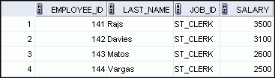
Using the ALL Operator in Multiple-Row Subqueries
SELECT employee_id, last_name, job_id, salary
FROM employees
WHERE salary < ALL
(SELECT salary
FROM employees
WHERE job_id = 'IT_PROG')
AND job_id <> 'IT_PROG';
9000, 6000, 4200
Notes:
Oracle Database 11g: SQL Fundamentals I 7 - <number>
Using the ALL Operator in Multiple-Row Subqueries
The ALL operator compares a value to every value returned by a subquery. The example in the slide displays employees whose salary is less than the salary of all employees with a job ID of IT_PROG and whose job is not IT_PROG.
>ALL means more than the maximum and <ALL means less than the minimum.
The NOT operator can be used with IN, ANY, and ALL operators.

Slide 33
Null Values in a Subquery
SELECT emp.last_name
FROM employees emp
WHERE emp.employee_id NOT IN
(SELECT mgr.manager_id
FROM employees mgr);
Notes:
Oracle Database 11g: SQL Fundamentals I 7 - <number>
Null Values in a Subquery
The SQL statement in the slide attempts to display all the employees who do not have any subordinates. Logically, this SQL statement should have returned 12 rows. However, the SQL statement does not return any rows. One of the values returned by the inner query is a null value, and, therefore, the entire query returns no rows.
The reason is that all conditions that compare a null value result in a null. So whenever null values are likely to be part of the results set of a subquery, do not use the NOT IN operator. The NOT IN operator is equivalent to <> ALL.
Notice that the null value as part of the results set of a subquery is not a problem if you use the IN operator. The IN operator is equivalent to =ANY. For example, to display the employees who have subordinates, use the following SQL statement:
SELECT emp.last_name
FROM employees emp
WHERE emp.employee_id IN
(SELECT mgr.manager_id
FROM employees mgr);

Slide 34
Thanks to All

